Slide 1
Chapter 4:
NEWTON’S SECOND LAW OF MOTION

Slide 2
Objectives
Force Causes Acceleration
Friction
Mass and Weight
Mass Resists Acceleration
Newton’s Second Law of Motion
Free Fall
Non-Free Fall

Slide 3
Force causes Acceleration
Acceleration depends on the net force.
Acceleration is directly proportional to net force.
To increase the acceleration of an object, you must increase the net force acting on it.
Acceleration ~ net force

Slide 4
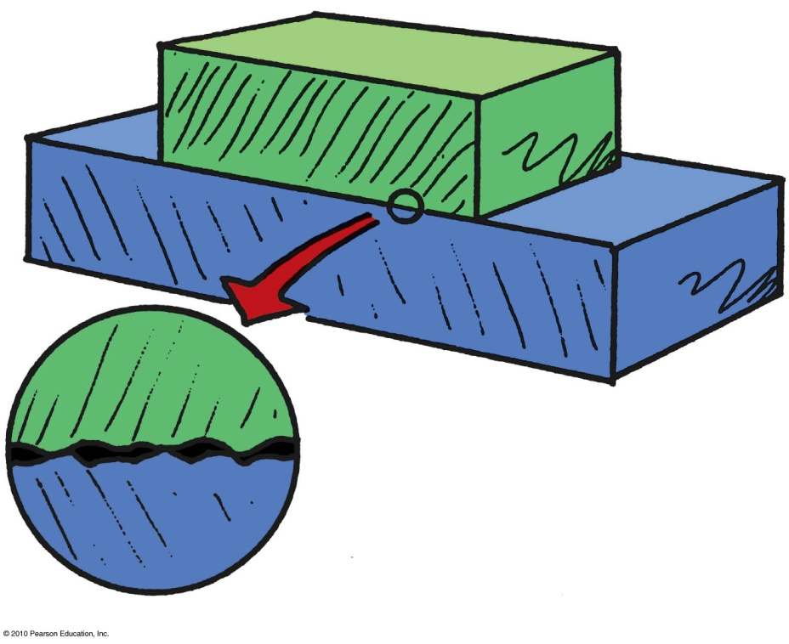
The Force of Friction
depends on the kinds of material and how much they are pressed together.
is due to tiny surface bumps and to “stickiness” of the atoms on a material’s surface.
Example: Friction between a crate on a smooth wooden floor is less than that on a rough floor.

Slide 5
The force of friction can occur
A. with sliding objects.
in water.
in air.
All of the above.
Notes:
D. all of the above.

Slide 6
The force of friction can occur
A. with sliding objects.
in water.
in air.
All of the above.
Comment:
Friction can also occur for objects at rest. If you push horizontally on your book and it doesn’t move, then friction between the book and the table is equal and opposite to your push.
Notes:
D. all of the above.

Slide 7
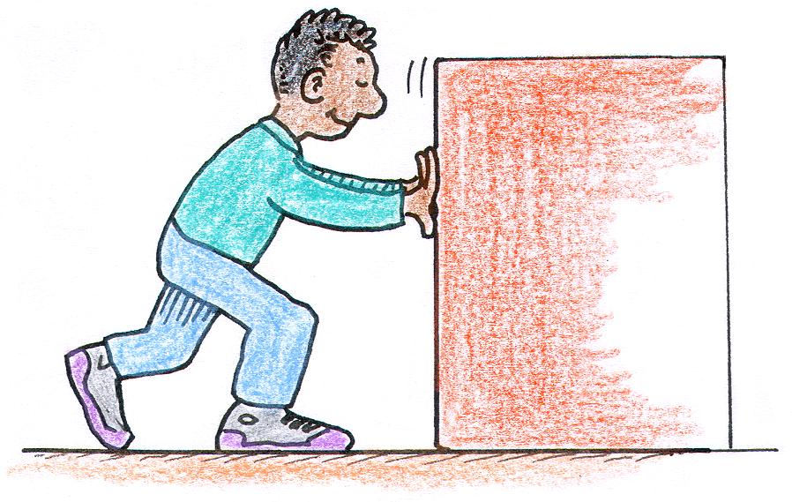
When Sanjay pushes a refrigerator across a kitchen floor at a constant speed, the force of friction between the refrigerator and the floor is
A. less than Sanjay’s push.
equal to Sanjay’s push.
equal and opposite to Sanjay’s push.
more than Sanjay’s push.
Notes:
C. equal and opposite to Sanjay’s push.

Slide 8
When Sanjay pushes a refrigerator across a kitchen floor at a constant speed, the force of friction between the refrigerator and the floor is
A. less than Sanjay’s push.
equal to Sanjay’s push.
equal and opposite to Sanjay’s push.
more than Sanjay’s push.
Notes:
C. equal and opposite to Sanjay’s push.

Slide 9
When Sanjay pushes a refrigerator across a kitchen floor at an increasing speed, the amount of friction between the refrigerator and the floor is
A. less than Sanjay’s push.
equal to Sanjay’s push.
equal and opposite to Sanjay’s push.
more than Sanjay’s push.
Notes:
A. less than Sanjay’s push.

Slide 10
When Sanjay pushes a refrigerator across a kitchen floor at an increasing speed, the amount of friction between the refrigerator and the floor is
A. less than Sanjay’s push.
equal to Sanjay’s push.
equal and opposite to Sanjay’s push.
more than Sanjay’s push.
Explanation:
The increasing speed indicates a net force greater than zero. The refrigerator is not in equilibrium.
Notes:
A. less than Sanjay’s push.

Slide 11
Mass and Weight
Mass: The quantity of matter in an object. It is also the measure of the inertia or sluggishness that an object exhibits in response to any effort made to start it, stop it, or change its state of motion in any way.
Weight: The force upon an object due to gravity.

Slide 12
Mass and Weight
Mass
A measure of the inertia of a material object
Independent of gravity
Greater inertia ⇒ greater mass
Unit of measurement is the kilogram (kg)
Weight
The force on an object due to gravity
Scientific unit of force is the newton (N)
Unit is also the pound (lb)
1N = 0.22 lb

Slide 13
Mass and Weight
In other words, mass is a measurement of how much matter is in an object.
Weight is a measurement of how hard gravity is pulling on that object

Slide 14
Mass and Weight
1 kilogram weighs 10 newtons
(9.8 newtons to be precise).
Relationship between kilograms and pounds:
1 kg = 2.2 lb = 10 N at Earth’s surface
1 lb = 4.45 N

Slide 15
If the mass of an object is halved, the weight of the object is
A. halved.
twice.
depends on location.
None of the above.
Notes:
A. halved.

Slide 16
If the mass of an object is halved, the weight of the object is
A. halved.
twice.
depends on location.
None of the above.
Notes:
A. halved.

Slide 17
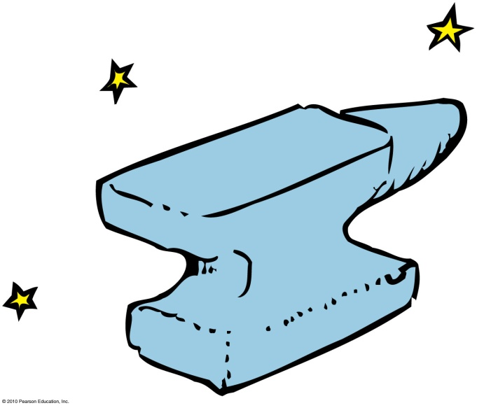
Mass and Weight
Mass and weight in everyday conversation are interchangeable.
Mass, however, is different and more fundamental than weight.
Mass versus weight
  on the Moon and Earth:
    Weight of an object on the Moon
    is less than on Earth.
    Mass of an object is the same
    in both locations.

Slide 18
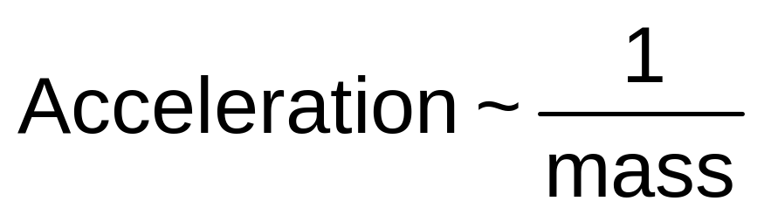
Mass Resists Acceleration
The same force applied to
Twice the mass produces half the acceleration.
3 times the mass, produces 1/3 the acceleration.
Acceleration is inversely proportional to mass.

Slide 19
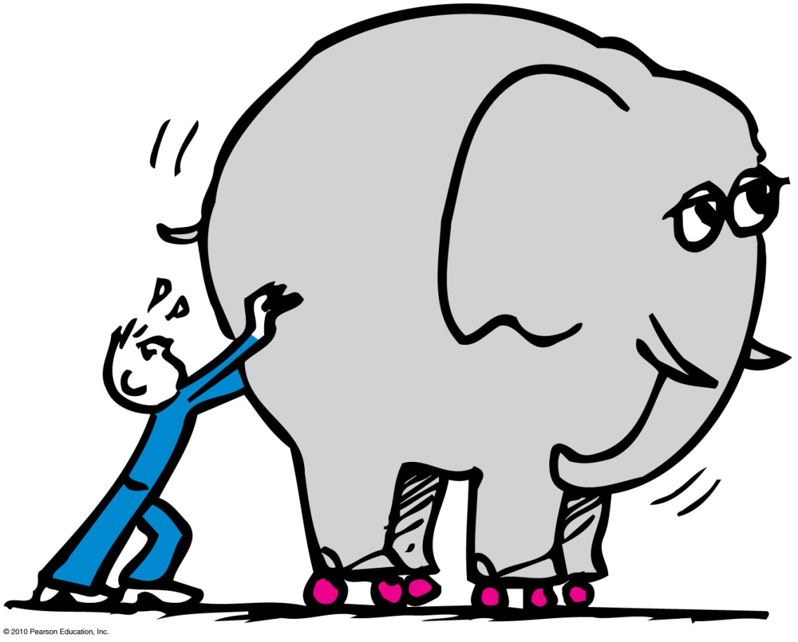
Newton’s Second Law of Motion
Isaac Newton was the first to connect the concepts of force and mass to produce acceleration.

Slide 20
Newton’s Second Law of Motion
Newton’s second law (the law of acceleration) relates acceleration to force.
  The acceleration produced by a net force on an object is directly proportional to the net force, is in the same direction as the net force, and is inversely proportional to the mass of the object.

Slide 21
Newton’s Second Law of Motion
In equation form:
Example:
  If net force acting on object is doubled ⇒
  object’s acceleration will be doubled.
  If mass of object is doubled ⇒
  object’s acceleration will be halved.
net force
Acceleration =
mass

Slide 22
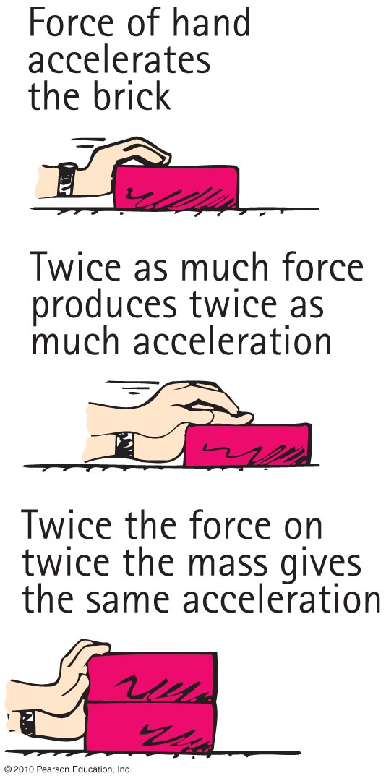
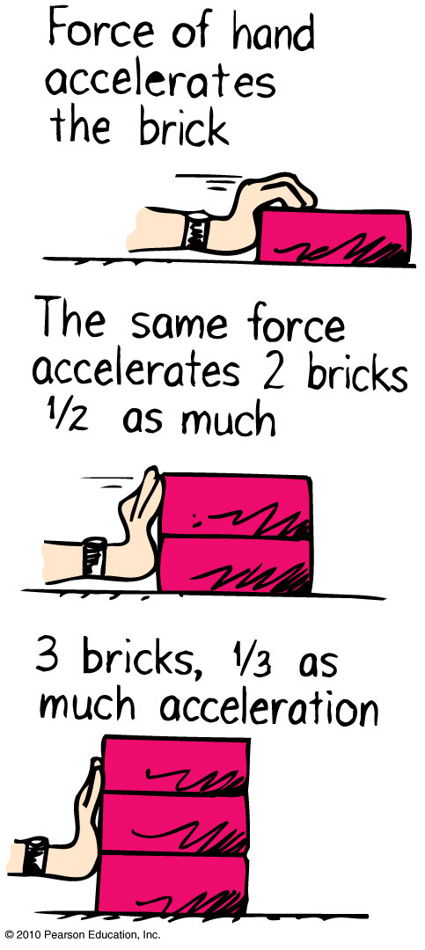
Newton’s Second Law of Motion

Slide 23
Consider a cart pushed along a track with a certain force. If the force remains the same while the mass of the cart decreases to half, the acceleration of the cart
remains relatively the same.
halves.
doubles.
changes unpredictably.

Slide 24
Consider a cart pushed along a track with a certain force. If the force remains the same while the mass of the cart decreases to half, the acceleration of the cart
remains relatively the same.
halves.
doubles.
changes unpredictably.
Explanation:
Acceleration = net force / mass
Because, mass is in the denominator,
acceleration increases as mass decreases.
So, if mass is halved, acceleration doubles.

Slide 25
Push a cart along a track so twice as much net force acts on it. If the acceleration remains the same, what is a reasonable explanation?
The mass of the cart doubled when the force doubled.
The cart experiences a force that it didn’t before.
The track is not level.
Friction reversed direction.

Slide 26
Push a cart along a track so twice as much net force acts on it. If the acceleration remains the same, what is a reasonable explanation?
The mass of the cart doubled when the force doubled.
The cart experiences a force that it didn’t before.
The track is not level.
Friction reversed direction.
Explanation:
Acceleration = net force / mass
If force doubles, acceleration will also double,
But it does not, so mass must also be doubling to cancel out effects of force doubling.

Slide 27
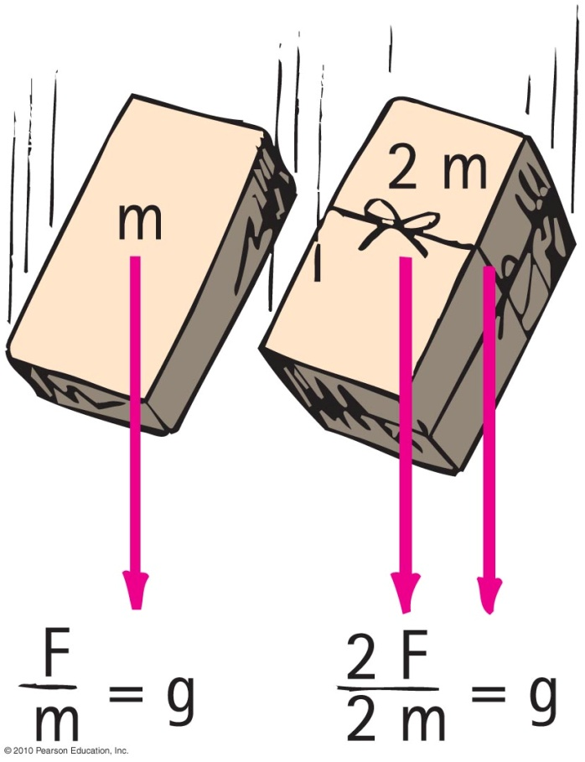
Free Fall
The greater the mass of the object…
the greater its force of attraction toward the Earth.
the smaller its tendency to move i.e., the greater its inertia.
So, the acceleration is the same.
It is equal to the acceleration due to gravity: 10 m/s²
(precisely 9.8 m/s²).

Slide 28
Free Fall
When acceleration is g—free fall
Newton’s second law provides an explanation for the equal accelerations of freely falling objects of various masses.
Acceleration is equal when air resistance is negligible.
Acceleration depends on force (weight) and inertia.

Slide 29
At one instant, an object in free fall has a speed of 40 m/s. Its speed 1 second later is
A. also 40 m/s.
45 m/s.
50 m/s.
None of the above.
Notes:
C. 50 m/s.

Slide 30
At one instant, an object in free-fall has a speed of 40 m/s. Its speed 1 second later is
A. also 40 m/s.
45 m/s.
50 m/s.
None of the above.
Comment:
We assume the object is falling downward.
Notes:
C. 50 m/s.

Slide 31
A 5-kg iron ball and a 10-kg iron ball are dropped from rest. For negligible air resistance, the acceleration of the heavier ball will be
A. less.
the same.
more.
undetermined.
Notes:
B. the same.

Slide 32
A 5-kg iron ball and a 10-kg iron ball are dropped from rest. For negligible air resistance, the acceleration of the heavier ball will be
A. less.
the same.
more.
undetermined.
Notes:
B. the same.

Slide 33
A 5-kg iron ball and a 10-kg iron ball are dropped from rest. When the free-falling 5-kg ball reaches a speed of 10 m/s, the speed of the free-falling 10-kg ball is
A. less than 10 m/s.
10 m/s.
more than 10 m/s.
undetermined.
Notes:
B. 10 m/s.

Slide 34
A 5-kg iron ball and a 10-kg iron ball are dropped from rest. When the free-falling 5-kg ball reaches a speed of 10 m/s, the speed of the free-falling 10-kg ball is
A. less than 10 m/s.
10 m/s.
more than 10 m/s.
undetermined.
Notes:
B. 10 m/s.

Slide 35

Non-Free Fall
When an object falls downward through the air it experiences
force of gravity pulling it downward.
air drag force acting upward.

Slide 36
Non-Free Fall
When acceleration of fall is less than g, non-free fall
  occurs when air resistance is non-negligible.
  depends on two things:
    speed and
    frontal surface area.

Slide 37
Non-Free Fall
When the object is moving fast enough that force of gravity equals its air resistance
Then no net force
  No acceleration
  Velocity does not change

Slide 38
Non-Free Fall
Terminal speed
occurs when acceleration terminates (when air resistance equals weight and net force is zero).
Terminal velocity
same as terminal speed, with direction implied or specified.

Slide 39
Non-Free Fall—Example
A skydiver jumps from plane.
Weight is the only force until air resistance acts.
As falling speed increases, air resistance on diver builds up, net force is reduced, and acceleration becomes less.
When air resistance equals the diver’s weight, net force is zero and acceleration terminates.
Diver reaches terminal velocity, then continues the fall at constant speed.

Slide 40
When a 20-N falling object encounters 5 N of air resistance, its acceleration of fall is
A. less than g.
more than g.
C. g.
terminated.
Notes:
A. less than g.

Slide 41
When a 20-N falling object encounters 5 N of air resistance, its acceleration of fall is
A. less than g.
more than g.
C. g.
terminated.
Comment:
Acceleration of a non-free fall is always less than g. Acceleration will actually be (20 N – 5 N)/2 kg = 7.5 m/s².
Notes:
A. less than g.

Slide 42
If a 50-N person is to fall at terminal speed, the air resistance needed is
A. less than 50 N.
50 N.
more than 50 N.
None of the above.
Notes:
B. 50 N.

Slide 43
If a 50-N person is to fall at terminal speed, the air resistance needed is
A. less than 50 N.
50 N.
more than 50 N.
None of the above.
Explanation:
Then, ΣF = 0 and acceleration = 0.
Notes:
B. 50 N.

Slide 44
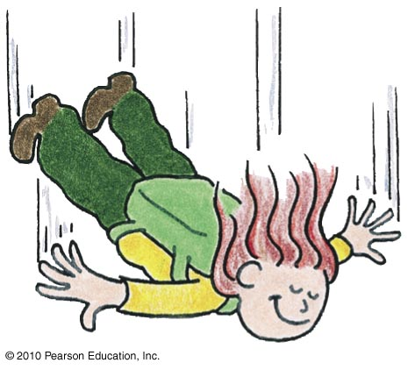
As the skydiver falls faster and faster through the air, air resistance
A. increases.
decreases.
remains the same.
Not enough information.
Notes:
A. increases.

Slide 45
As the skydiver falls faster and faster through the air, air resistance
A. increases.
decreases.
remains the same.
Not enough information.
Notes:
A. increases.

Slide 46
As the skydiver continues to fall faster and faster through the air, net force
A. increases.
decreases.
remains the same.
Not enough information.
Notes:
B. decreases.

Slide 47
As the skydiver continues to fall faster and faster through the air, net force
A. increases.
decreases.
remains the same.
Not enough information.
Notes:
B. decreases.

Slide 48
As the skydiver continues to fall faster and faster through the air, her acceleration
A. increases.
decreases.
remains the same.
Not enough information.
Notes:
B. decreases.

Slide 49
As the skydiver continues to fall faster and faster through the air, her acceleration
A. increases.
decreases.
remains the same.
Not enough information.
Notes:
B. decreases.

Slide 50
Consider a heavy and light person jumping together with same-size parachutes from the same altitude. Who will reach the ground first?
A. The light person.
The heavy person.
Both will reach at the same time.
Not enough information.
Notes:
B. The heavy person.

Slide 51
Consider a heavy and light person jumping together with same-size parachutes from the same altitude. Who will reach the ground first?
A. The light person
The heavy person
Both will reach at the same time.
Not enough information.
Explanation:
They both have the same drag force (for the same speed).
The heavier person has a greater downward force than the lighter person.
The heavier person has to drop farther to receive drag force equal to his downward force, so a higher terminal velocity.
Notes:
B. The heavy person.

Slide 52
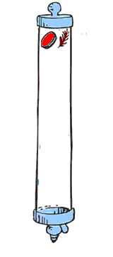
Free Fall vs. Non-Free Fall
Coin and feather fall with air present
Feather reaches terminal velocity very quickly and falls slowly at constant speed, reaching the bottom after the coin does.
Coin falls very quickly and air resistance
doesn’t build up to its weight over
short-falling distances, which is why
the coin hits the bottom much sooner
than the falling feather.

Slide 53
When the air is removed by a vacuum pump and the coin and feather activity is repeated,
A. the feather hits the bottom first, before the coin hits.
the coin hits the bottom first, before the feather hits.
both the coin and feather drop together side-by-side.
Not enough information.
Notes:
C. both the coin and feather drop together side-by-side.

Slide 54
When the air is removed by a vacuum pump and the coin and feather activity is repeated,
A. the feather hits the bottom first, before the coin hits.
the coin hits the bottom first, before the feather hits.
both the coin and feather drop together side-by-side.
Not enough information.
Notes:
C. both the coin and feather drop together side-by-side.

Slide 55
Free Fall vs. Non-Free Fall
Coin and feather fall in vacuum
There is no air, because it is vacuum.
So, no air resistance.
Coin and feather fall together.

Slide 56
Chapter 4 Problems
6. Leroy, who has a mass of 100 kg, is skateboarding at 9.0 m/s when he smacks into a brick wall and comes to a dead stop in 0.2 s.
Show that his deceleration is 45 m/s².
a = (v_{final}– v_{initial}) / (t_{final}–t_{initial} ) = -9 m/s /0.2s = -45 m/s²
Show that the force of impact is 4500 N. (ouch!!)
F = ma = 100kg x -45 m/s² = 4500 kg m/s² = -4500 N

Slide 57
Summary of Terms
Friction The resistive force that opposes the motion or attempted motion of an object either past another object with which it is in contact or through a fluid.
Mass The quantity of matter in an object. More specifically, it is the measure of the inertia or sluggishness that an object exhibits in response to any effort made to start it, stop it, deflect it, or change in anyway its state of motion.
Weight The force due to gravity on an object.
Kilogram The fundamental SI unit of mass. One kilogram (symbol kg) is the mass of 1 liter (1 L) of water at 4°C.
Newton The SI unit of force. One newton (symbol N) is the force that will give an object of mass 1 kg an acceleration of 1 m/s2.
Volume The quantity of space an object occupies.

Slide 58
Summary of Terms
Newton's second law - The acceleration of an object is directly proportional to the net force acting on the object, is in the direction of the net force, and is inversely proportional to the mass of the object.
Force - Any influence that can cause an object to be accelerated, measured in Newtons (or in pounds, in the English system).
Free fall - Motion under the influence of gravitational pull only.
Terminal speed - The speed at which the acceleration of a falling object terminates because air resistance balances its weight. When direction is specified, then we speak of terminal velocity.

Slide 59
Homework
Read Chapter 4 in Detail.
Do Ranking 2
Do Exercises 2, 8, 15
Do Problem 4
Homework due: June 04

